Slide 1
HTTP with Sessions and Cookies
Cybersecurity
Lesson 13.1

Slide 2

Learning Objectives
By the end of today’s class, you will be able to:
1
Understand HTTP requests and responses.
2
Use the curl command-line tool to make GET and POST requests and examine the responses.
3
Explain different cookie types (permanent and third-party).
4
Manage cookies using the Chrome extension Cookie-Editor.
5
Use Chrome's Developer Tools to audit HTTP request and response headers.

Slide 4

The Web: A Security Perspective
In previous units, we learned
about system administration and networking concepts.
This week, we’ll build on those concepts as we explore how web-based communication
works in the client–server model.
We’ll examine how we communicate over the web (networking) and
how websites and web applications are created and deployed
(system administration).

Slide 5

Web Development Overview
Throughout this week, we will consider how web applications work from the perspectives of the user and the web developer/architect.
This week, we’ll cover the following:
What happens behind the scenes when we visit a webpage.
How websites “remember” us through cookies and sessions.
The architecture of web applications.
Deploying and managing data
in a web application.

Slide 6
Overview of Today’s Topics
Today’s topics will focus on what happens when we do everyday online activities, such as visit a website or log into an e-commerce site. Specifically, we will look at:
1
How our browsers send and receive data from a web server.
2
Using our browser to dive deeper into the data being sent back and forth.
3
Using the command line to craft, manipulate, and examine data over the web.
4
How web applications “remember” who we are.

Slide 7

Intro to the Modern Web

Slide 8


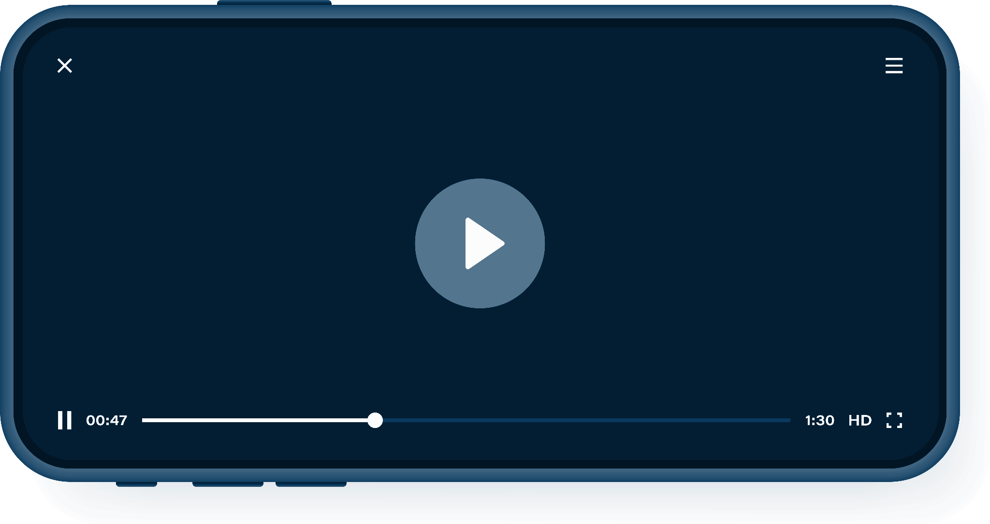
Introduction to the Modern Web
It’s increasingly important for security professionals to understand the web for the following reasons:
Organizations are incorporating more web-based applications and services, such as Salesforce, into their operations.
Companies are moving their on-premises infrastructure and services to the cloud—e.g., using cloud-based backup services for servers.
Most people access the web on a daily basis, whether for shopping or streaming videos.

Slide 9

Introduction to the Modern Web
Some of the major security roles that focus on web technologies are:
Penetration testers are ethical hackers who find and exploit vulnerabilities to gain privileged access to web applications.
Web application security engineers
must deeply understand how their company’s web application works and how to secure it.
Risk assessors
must understand the risk profiles and tolerances within web applications so they can help companies follow best practices and policies.

Slide 10

The Web: A Security Perspective
The threats embedded in the modern web are constantly growing.
The web represents most organizations’ largest attack surface.
The number of users accessing the web at all times, through PCs, phones, and other devices, is growing constantly.
The collective amount of personal data stored on the web is growing significantly.
Attackers can steal and sell this data.

Slide 11
HTTP Requests and Responses

Slide 12
Preliminary Information
Securing the web requires in-depth knowledge of topics we’ve covered:
Client–Server Architecture
HTTP (Hypertext Transfer Protocol)
HTTP Requests
HTTP Responses

Slide 13
The exchange of information through a cycle of requests and responses between clients and servers is known as the client–server model.

Slide 14



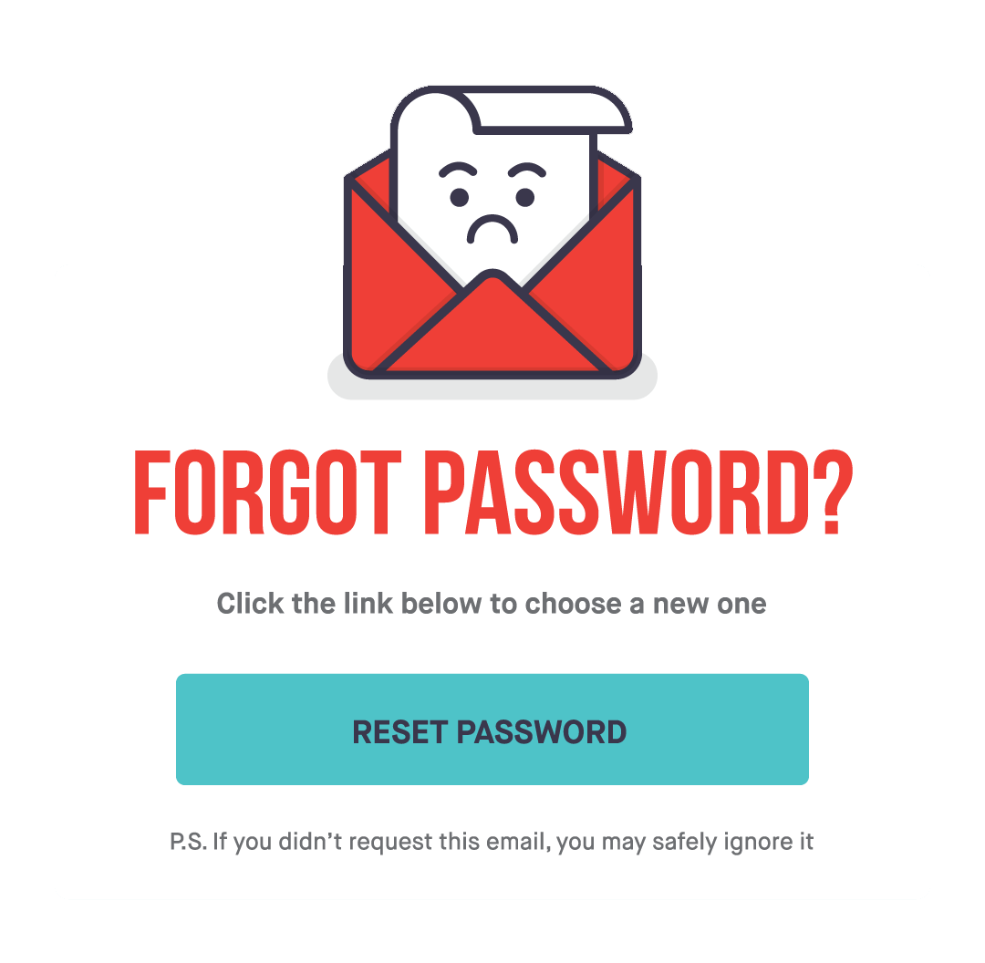


Client–Server Architecture
HTTP
Request
Request
Request
Response
Response
Response
Client
Web server
Application server
Database server
A user’s device communicates with a server to request resources from it.
The server queries the resources from internal servers to which it is connected.
The application server sends and receives data from the database server.
The data resides within the database server.

Slide 15
HTTP Requests
Layer 7: Application
HTTP is an OSI Layer 7 protocol that websites and web applications use to communicate with user devices.
Layer 6: Presentation
Layer 5: Session
Layer 4: Transport
Layer 3: Network
Layer 2: Data Link
Layer 1: Physical

Slide 16

When a client, such as a web browser, initiates communication, it generates an HTTP request. The server receives the request, finds the requested resource, and sends it back to the client.
HTTP Requests
HTTP is used to transfer web pages; static assets, such as images and HTML/markup files; and raw data, such as MP4 video or MP3 audio.
The client sends a request for info to the server.
Client: I’d like file A, please.
Request
Response
The server responds with data.
Server: Here’s the file A you asked for.
A

Slide 17







There are various types of requests, known as HTTP methods, that indicate the specific actions between the client and server. For example:
HTTP Methods
A user can request data
from a server.
A user can give data
to a server.
A user can update data
on a server.
“I’d like to see my friend’s
photos on Facebook.”
“Here are my credentials
for my LinkedIn account.”
“I'd like to reset my
Zoom password.”

Slide 18
HTTP Request Methods
There are various HTTP request methods:
HTTP Method | Description
GET | Requests data from a server.
HEAD | Identical to GET, but the server does not send the response body.
POST | Sends data to a source, often changing or updating a server.
PUT | Replaces current data with the new value.
DELETE | Deletes a specified resource.
CONNECT | Establishes a tunnel to the server.
OPTIONS | Lists the communication options for a target resource.

Slide 19
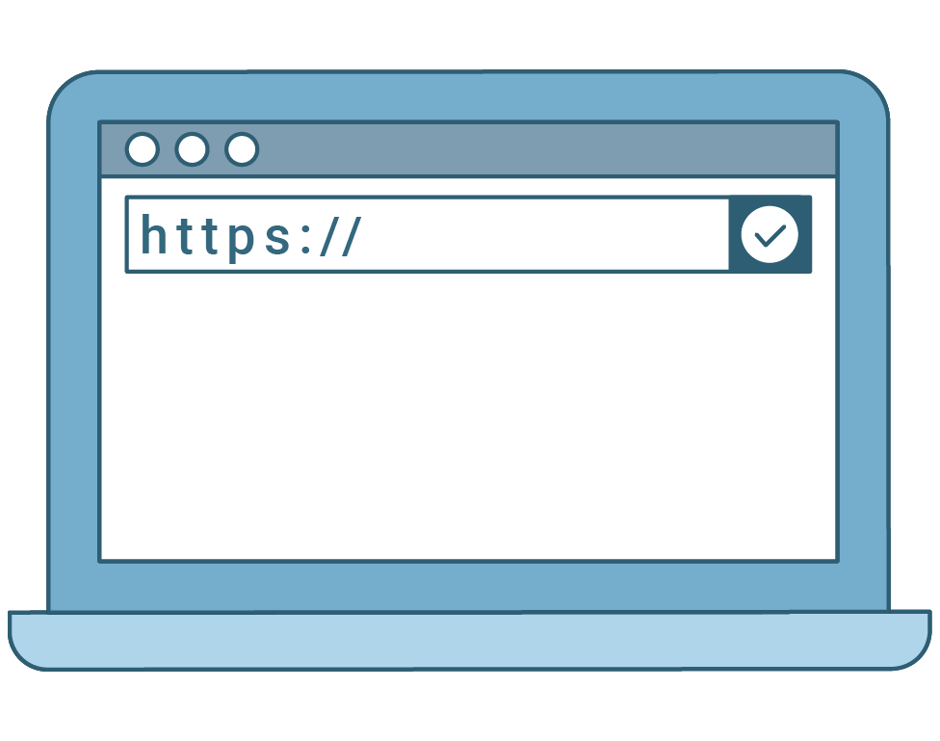
HTTP Requests and Responses
HTTP Request Methods
GET Requests
Requests data from a server.
When you open a browser and go
to amazon.com, the HTTP client (your browser) asks to GET the
data that the URL (amazon.com) points to. That data is the webpage.

Slide 20
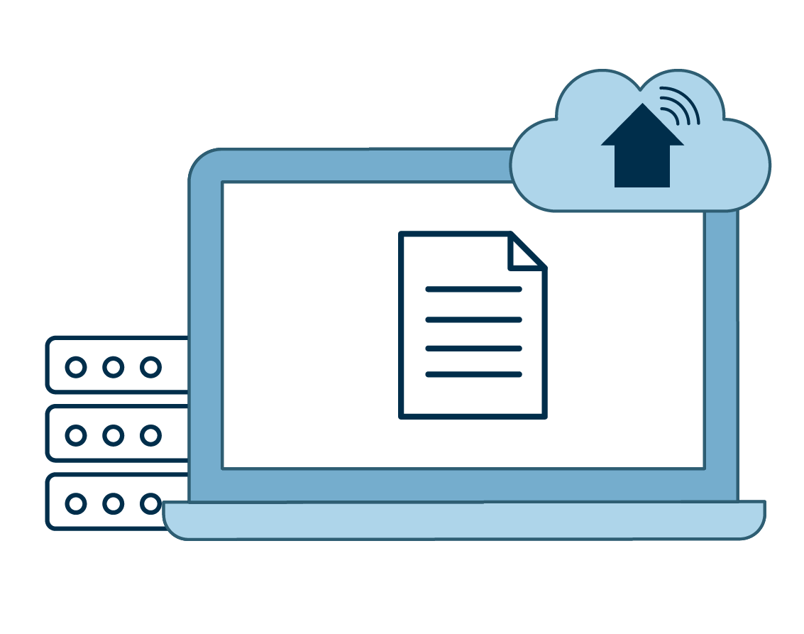
HTTP Requests and Responses
HTTP Request Methods
POST Requests
Sends data to a source, often changing or updating a server. Once your browser goes to amazon.com, you log in to your Amazon account. The client sends a POST request that contains your credentials for logging in.

Slide 21
Anatomy of HTTP Requests
and Responses

Slide 22
Anatomy of a GET Request
GET /js/analytics.js HTTP/1.1
Host: www.target-server.com
Connection: keep-alive
Upgrade-Insecure-Request: 1
Accept: text/js, text/html, */*
Accept-Language: en-us
Accept-Encoding: gzip, deflate
User-Agent: Mozilla/4.0
Request line
Headers
Whitespace
Request body (optional)

Slide 23
Anatomy of a GET Request
GET /js/analytics.js HTTP/1.1
Host: www.target-server.com
Connection: keep-alive
Upgrade-Insecure-Request: 1
Accept: text/js, text/html, */*
Accept-Language: en-us
Accept-Encoding: gzip, deflate
User-Agent: Mozilla/4.0
Request line
Contains the request method, the name of the requested resource, and the version of HTTP in use.
Can also contain query parameters, which the client can use to send data to the server.
Headers
Whitespace
Request body (optional)

Slide 24
Anatomy of a GET Request
GET /js/analytics.js HTTP/1.1
Host: www.target-server.com
Connection: keep-alive
Upgrade-Insecure-Request: 1
Accept: text/js, text/html, */*
Accept-Language: en-us
Accept-Encoding: gzip, deflate
User-Agent: Mozilla/4.0
Request line
Headers
Contain additional details about the requested resource.
Contain many actions with security implications, like authentication and remembering user resources.
You don’t have to remember every type of header. We’ll cover some of the most important ones in class.
Whitespace
Request body (optional)

Slide 25
Anatomy of a GET Request
GET /js/analytics.js HTTP/1.1
Host: www.target-server.com
Connection: keep-alive
Upgrade-Insecure-Request: 1
Accept: text/js, text/html, */*
Accept-Language: en-us
Accept-Encoding: gzip, deflate
User-Agent: Mozilla/4.0
Request line
Headers
Whitespace
A blank line indicating the end of the request.
Request body (optional)

Slide 26
HTTP Request: Request Line
GET /js/analytics.js HTTP/1.1
Host: www.target-server.com
Connection: keep-alive
Upgrade-Insecure-Request: 1
Accept: text/js, text/html, */*
Accept-Language: en-us
Accept-Encoding: gzip, deflate
User-Agent: Mozilla/4.0
The request method is GET.
The requested resource is /js/analytics.js.
This resource is the file path from the domain stated in the header.
The request browser uses
HTTP version 1.1.

Slide 27
HTTP Request: Headers
GET /js/analytics.js HTTP/1.1
Host: www.target-server.com
Connection: keep-alive
Upgrade-Insecure-Request: 1
Accept: text/js, text/html, */*
Accept-Language: en-us
Accept-Encoding: gzip, deflate
User-Agent: Mozilla/4.0
Host contains the domain name of the target server.
Note that the protocol
(HTTP) + host + file path in the request line is the URL we see in the browser:
http://www.target-server.com/js/analytics.js

Slide 28
HTTP Request: Headers
GET /js/analytics.js HTTP/1.1
Host: www.target-server.com
Connection: keep-alive
Upgrade-Insecure-Request: 1
Accept: text/js, text/html, */*
Accept-Language: en-us
Accept-Encoding: gzip, deflate
User-Agent: Mozilla/4.0
Connection instructs the server to keep the TCP connection open after sending the response. The TCP is the connection used for the HTTP transfer.
This allows the client server to reuse the connection for later requests.
The alternative is performing a TCP handshake, which is much slower.

Slide 29
HTTP Request: Headers
GET /js/analytics.js HTTP/1.1
Host: www.target-server.com
Connection: keep-alive
Upgrade-Insecure-Request: 1
Accept: text/js, text/html, */*
Accept-Language: en-us
Accept-Encoding: gzip, deflate
User-Agent: Mozilla/4.0
Upgrade-Insecure-Requests instructs the server to turn this HTTP connection into HTTPS,
so the response and future communications will be encrypted.
Accept informs the server that the client expects a JavaScript or HTML document in response, but will accept data of any type (*/*).
User-Agent informs the server
that this request comes from a Mozilla 4.0 browser.

Slide 30
Headers
Other important headers include:
Authorization | Contains credentials to authenticate a user with a server.
Referer | Contains the address of the previous webpage that linked to the currently requested page. Allows servers to identify where people are visiting from and use that data for analytics, logging, or optimized caching. (If a link from a Google search led to the current page, the referer is Google.)
Cookie | Contains stored HTTP cookies previously sent by the server with the Set-Cookie response header.

Slide 31
Requests with Query Parameters
GET requests can also request data with query parameters:
GET /articles?tag=latest&author=jane HTTP/1.1
Host: www.target-server.com
Connection: keep-alive
Upgrade-Insecure-Request: 1
Accept: text/js, text/html, */*
Accept-Language: en-us
Accept-Encoding: gzip, deflate
User-Agent: Mozilla/4.0
Query parameters are useful for specifying the parts of a resource to receive or send data.
This GET request specifically requests articles with two Parameters: the latest articles, created by the author jane.

Slide 32
Requests with Query Parameters
GET requests can also request data with query parameters.
GET /articles?tag=latest&author=jane HTTP/1.1
Note the syntax for parameters:
[path]?[firstParam]=[value]&[secondParam]=[value]
Query parameters are useful for specifying the parts of a resource to receive or send data. This GET request specifically requests articles with two parameters: the latest articles, created by the author jane.

Slide 33
Anatomy of a POST Request
HTTP POST requests are similar to GET requests, but include a request body below the whitespace.
POST /api/users HTTP/1.1
Host: www.target-server.com
User-Agent: Mozilla/4.0
Accept: */*
Content-Length: 23
Content-Type: application/x-www-form-urlencoded
username=Jane+Doe&password=p455
The request body may contain information such as login credentials or a file to be uploaded.
In the current example, our request body contains login credentials.

Slide 34
Anatomy of an HTTP Response
HTTP/1.1 200 OK
Date: Nov 12 02:12:12 2018
Server: Apache/2.4.7 (Ubuntu)
X-powered-By: PHP/5.5.9-lubuntu4.21
Cache-Control: no-cache
Set-Cookie: SESSID=8toks; httponly
Content-Encoding: gzip
Content-Length: 698
function getStats(event) {
...
Status line
Headers
Whitespace
Response body

Slide 35
Anatomy of an HTTP Response
Status line | Contains the response status code and phrase that translates the result, such as OK or Error.
Headers | Contain additional information about the response, similar to request headers.
Whitespace | Separates the header from the following response body.
Response body | Contains the resource requested by the client.

Slide 36
Anatomy of an HTTP Response
HTTP/1.1 200 OK
Date: Nov 12 02:12:12 2018
Server: Apache/2.4.7 (Ubuntu)
X-powered-By: PHP/5.5.9-lubuntu4.21
Cache-Control: no-cache
Set-Cookie: SESSID=8toks; httponly
Content-Encoding: gzip
Content-Length: 698
function getStats(event) {
...
The response uses
unencrypted HTTP/1.1.
The status code is 200 OK,
meaning that the request was processed properly.

Slide 37
Anatomy of an HTTP Response
HTTP/1.1 200 OK
Date: Nov 12 02:12:12 2018
Server: Apache/2.4.7 (Ubuntu)
X-powered-By: PHP/5.5.9-lubuntu4.21
Cache-Control: no-cache
Set-Cookie: SESSID=8toks; httponly
Content-Encoding: gzip
Content-Length: 698
function getStats(event) {
...
Date contains a timestamp of when the response was generated.
Server indicates the server is running PHP version 5.5.9 on Lubuntu, with kernel version 4.21.

Slide 38
Anatomy of an HTTP Response
HTTP/1.1 200 OK
Date: Nov 12 02:12:12 2018
Server: Apache/2.4.7 (Ubuntu)
X-powered-By: PHP/5.5.9-lubuntu4.21
Cache-Control: no-cache
Set-Cookie: SESSID=8toks; httponly
Content-Encoding: gzip
Content-Length: 698
function getStats(event) {
...
Set-Cookie instructs the client to create a cookie called SESSID with the value 8toks and that this cookie can only be set by the server with HTTP.
We’ll discuss cookies and httponly in greater detail later.

Slide 39
Anatomy of an HTTP Response
HTTP/1.1 200 OK
Date: Nov 12 02:12:12 2018
Server: Apache/2.4.7 (Ubuntu)
X-powered-By: PHP/5.5.9-lubuntu4.21
Cache-Control: no-cache
Set-Cookie: SESSID=8toks; httponly
Content-Encoding: gzip
Content-Length: 698
function getStats(event) {
...
Below the whitespace is the response body, which contains
the source code of the resource requested in the GET request.

Slide 40

Status Codes
General status codes include:
200 Codes | Indicate success.
300 Codes | Indicate multiple choices, meaning the server can respond to the request in more than one way.
400 Codes | Indicate client errors, meaning the client sent an improperly formatted request.
500 Codes | Indicate server errors, meaning the server application failed somehow.
You probably recognize the 404 error.

Slide 41
A standard reference site for general headers
and web information is Mozilla Developer Network.

Slide 42
Key Takeaways
1
HTTP requests are sent from an HTTP client to an HTTP server.
2
HTTP responses are sent back from the HTTP server as a response to the client.
3
HTTP requests include a request line, request header, and optional request body.
4
HTTP responses include a status line, response header, and usually, a response body.
5
Query parameters allow you to be specific about the parts of a resource you want to send or receive data from.

Slide 43
Key Takeaways
6
GET requests ask an HTTP server for resources, such as a whole webpage.
7
POST requests send data to an HTTP server’s resources, such as login credentials or images for a webpage.
8
PUT requests also send data to an HTTP server, but are often used to overwrite resources, such as updating part of a webpage.
9
OPTIONS requests ask an HTTP server to respond with all HTTP methods that the HTTP server is programmed to respond to.

Slide 44

HTTP Request and Response
In this activity, you will be playing the role of a web app security engineer.
There is a breach in one of your company's HTTP servers. Before the server goes down, a suspicious IP address sends it a rapid sequence of requests and responses.
You are tasked with investigating the remaining HTTP logs to figure out what happened during the attack on the web server.
15 Minutes

Slide 47

Sessions and Cookies

Slide 48

HTTP resources are inherently stateless, meaning that, whenever your browser requests a webpage, there’s no way for that webpage to distinguish you from anyone else.
Sessions and Cookies
Request
Client: Hi! Remember me?
Response
Server: Umm... No?

Slide 49


Websites need a way to deliver content that is specific to each user. To do so, they establish sessions with cookies.
Sessions and Cookies
Sessions
Cookies
Unique server-side sets of user data used to customize webpages for the specific user accessing them.
Small pieces of text data that, when sent by an HTTP server’s response header, are saved by the user’s
HTTP client.

Slide 50
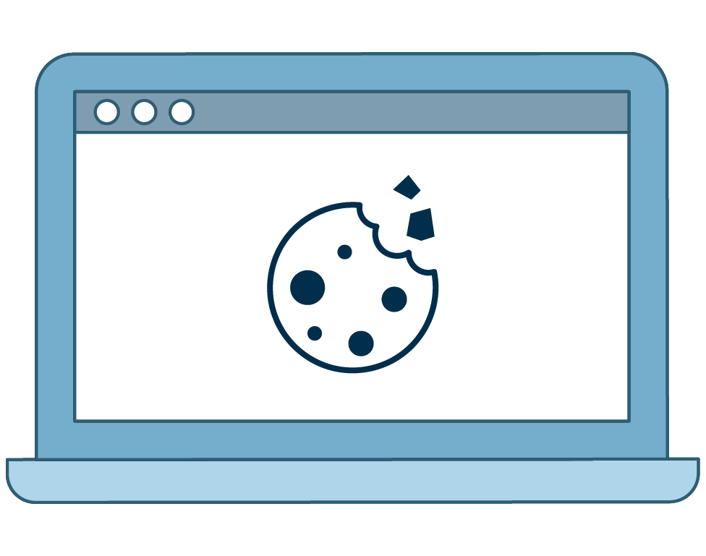
Sessions and Cookies
Cookies are used primarily for three things:
Session Management
Personalization
Tracking
Common cookie types:
Session Cookies
  Generated when user interacts with a website
Persistent Cookies
  Stay on a user’s computer for specified time
Token Authentication Cookies
  Help protect sensitive information
Third-Party/Tracking Cookies
  Record user activity
Zombie Cookies
  Used for malicious purposes

Slide 51




You visit a shopping website and register an account with your first and last name.
As soon as you do this, a session is created that saves your name to the site’s database.
Sessions and Cookies
GET /page.html HTTP/1.1
Site: example.com
Cookie: <None>
User without cookies
Default webpage
Cookie-detected
auto-forwarded
GET request
GET /page.html HTTP/1.1
Site: example.com
Cookie: User=Bob
Users with cookies
Default webpage
Personalized webpage

Slide 52
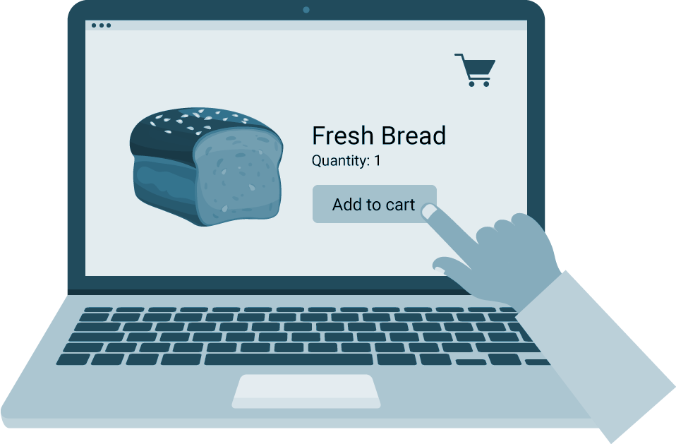
Before the session:
Bob visits a shopping site and clicks a button to add one loaf of bread to his shopping cart.
How a Session is Created

Slide 53

How a Session is Created
HTTP server
Create cookie
The HTTP server processes the POST request and creates a cookie for Bob.
Post request
The button sends
a POST request to the HTTP server with Bob’s one cart item.
Initiate session
In the database
POST /products/ HTTP/1.1
User-Agent: Mozilla/4.0
Host:example.com
Content-Type: text/html
Connection: Keep-Alive
Accept-Encoding: gzip, deflate
addItem=Bread&count=1
Database
Create session
The site’s database stores the session info with Bob’s shopping list and links it to the cookie.
Bob’s session

Slide 54
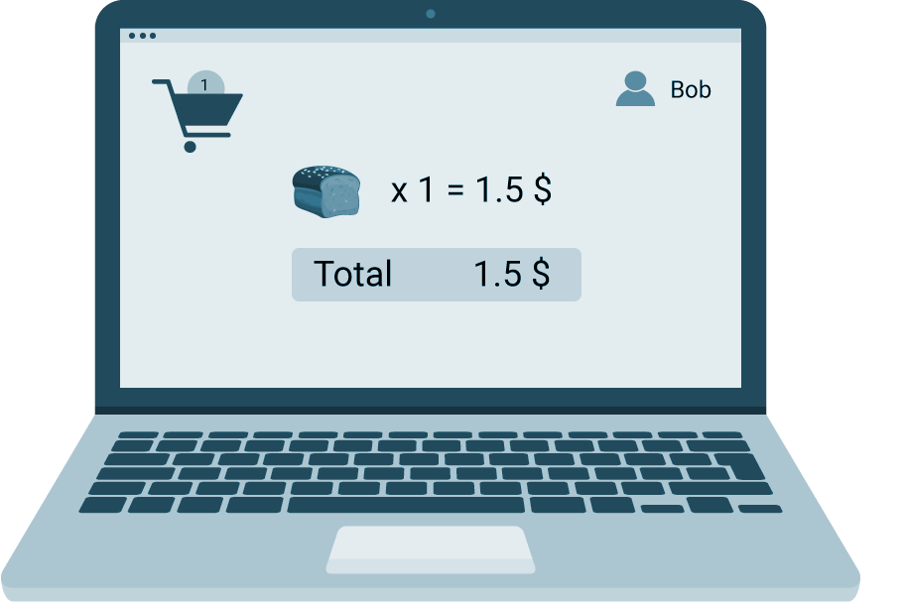
The HTTP server sends a response back to Bob’s browser with:
How a Session is Created
A cookie, sent through the response header.
HTTP/1.1 200 OK
Date: Fri, 13 Mar 2020 12:28:53 GMT
Server: Apache/2.2.14 (Win32)
Content-Length: 88
Content-Type: text/html
Set-Cookie: cart=Bob
<html><head>Bob’s cart<head>...
Response
Bob’s session information, embedded in the response body.

Slide 55
Resuming the response:
When Bob revisits the webpage, his browser sends the cookie back through the request header.
How a Session is Created
HTTP Server
GET /stuff/ HTTP/ 1.1
User-Agent: Mozilla/4.0
Host: example.com
Cookie: cart=Bob
Content-Type: text/html
Connection: Keep-Alive
Accept-Encoding: gzip. deflate
Response

Slide 56

Sessions and Cookies
Cookies and Attacks
Cookies can be set and read by JavaScript, a powerful web-based programming language that attackers often use in attacks such as:
Cross-Site Scripting
Clickjacking
Session Hijacking
We’ll cover these types of attacks in later modules.

Slide 57
Implementations of cookies vary between sites. Some are more secure than others.
How a Session is Created
1
If Bob’s account was the fifth account to ever be created on a website, his cookie might look like Set-Cookie: Session-ID=5.
2
An attacker can change their cookie’s value so that when they make a request, they do so as Bob.
3
Modern session cookies contain uniquely hashed values specific to users, e.g.,
Set-Cookie: Session-ID=299367cd4c0e2c6d3ae6e09eda4e0590.
4
While this keeps session ID cookies from being reverse-engineered, an attacker can still commit man-in-the-middle attacks by stealing cookies.

Slide 58
Summary
A cookie is used to implement a user's session.
A client and server exchange cookies through headers.
Clients save cookies locally.
A client sends a cookie via the cookie header.
A server sends a cookie via the Set-Cookie header.
Bad implementations of cookies can be spoofed or stolen, and cookies with modern implementations can be stolen.

Slide 59

Examine HTTP, Cookies, and Security

Slide 60
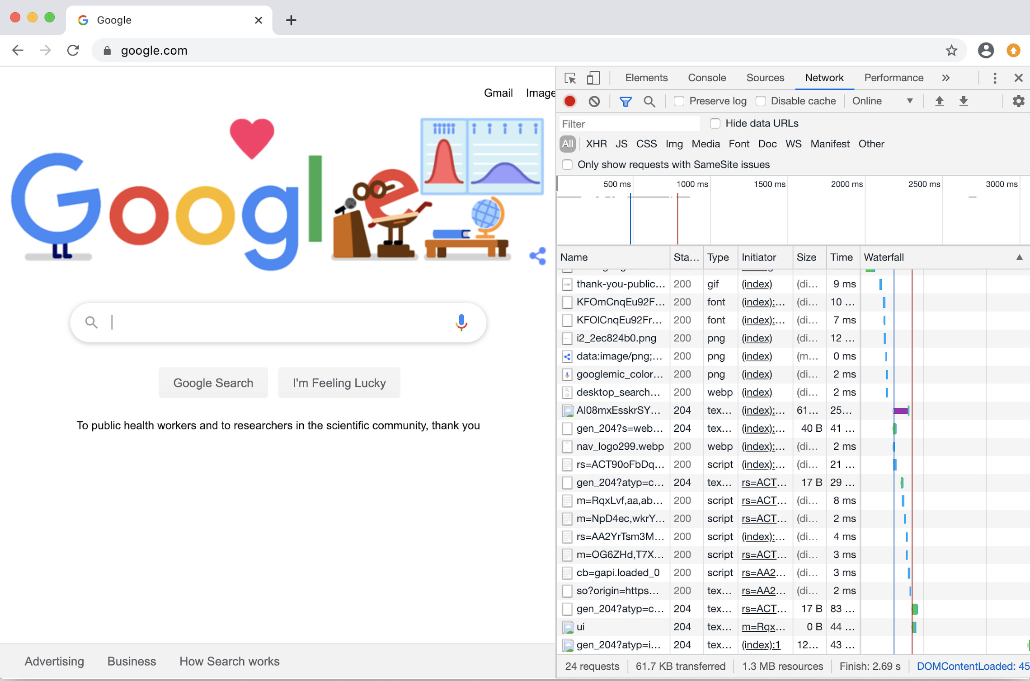
Chrome Developer Tools
Now, we’ll deconstruct and examine a web application using the tools within a browser.
These allow us to:
Understand the request and response flows between an HTTP client and server.
Examine the security implementations of a website through its response headers.
Identify where cookies are used in the HTTP request–response cycle.

Slide 61
Chrome Developer Tools

Slide 62
Inspect with Developer Tools
For this activity, you will continue in your role as a web app security engineer.
You are tasked with examining the various requests and response headers of one of your vendor's websites to assess its HTTP security.
For this activity, you'll use Chrome Developer Tools to examine the initial request and response set from www.crowdstrike.com.
10 Minutes

Slide 66

curl

Slide 67

It’s not always possible to examine HTTP requests and
responses through a browser. Sometimes the tools you can
use to send and receive HTTP requests are limited.

Slide 68
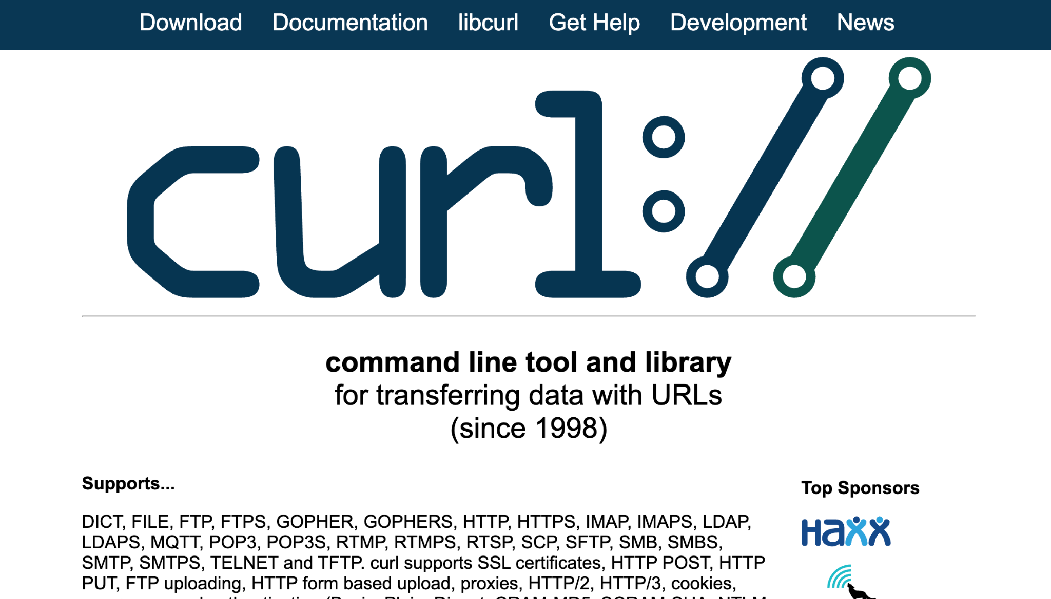
Introducing curl
For example, when working through a container that has no user interface, you’ll need a command-line tool to send and receive HTTP requests.
The command-line tool, curl, allows security professionals to quickly test HTTP requests in a way that can be automated, while allowing them to make adjustments as they work.

Slide 69
curl is a command-line client that allows us to send data to and from servers.

Slide 70

curl
Sends Customized HTTP Requests
curl allows security professionals to:
Test web server security configurations
Ensure web servers don’t leak sensitive data
Verify servers only respond to certain requests
Look for vulnerabilities on a web server

Slide 71
As a command-line tool, curl can be used in conjunction with other command-line tools, such as grep, sed, and awk.

Slide 72
curl

Slide 73
Using curl
For this activity, you will continue in your role as a web app security engineer.
You are tasked with writing various curl commands to interact with an HTTP web server.
You will use various curl options, request methods, and request headers to return specific responses.
15 Minutes

Slide 76
We’ll use a Chrome extension called Cookie-Editor to take a closer look at sessions and cookies in our browser.

Slide 77

Cookie Editor
Managing User Sessions
Cookie-Editor is an extension that works with Google Chrome allowing:
Import users’ cookies
Export users’ cookies
Save users’ cookies

Slide 78

Demonstration Scenario
In this demo for using Cookie-Editor, we’ll complete the following steps:
Enable the Chrome extension Cookie-Editor.
Create a user on a webpage and export their cookie to the clipboard with Cookie-Editor.
Create a new user, which will overwrite the old user's cookie and session.
Use the Cookie-Editor extension to import back the first user's session to show how a simple tool can be used to swap sessions.
Notes:
shutterstock_1888488028

Slide 79
Cookie-Editor

Slide 80
Swap Sessions
For this activity, you will continue your role as a web app security engineer.
After the previous web server was compromised, your company decides to use WordPress as a platform for its new e-commerce site.
You are tasked with using the Chrome browser extension Cookie-Editor with your company's WordPress site to examine the process an attacker might take to hijack a session.
25 Minutes

Slide 83
Microservices and Web Application Architecture

